Slide 1
Visual Studio
Debugging
Carlos.Leigue@Jalasoft.com

Slide 2
Agenda
Start Debugging
Run to Cursor
Breakpoints
Attach to Process …
Windows

Slide 3

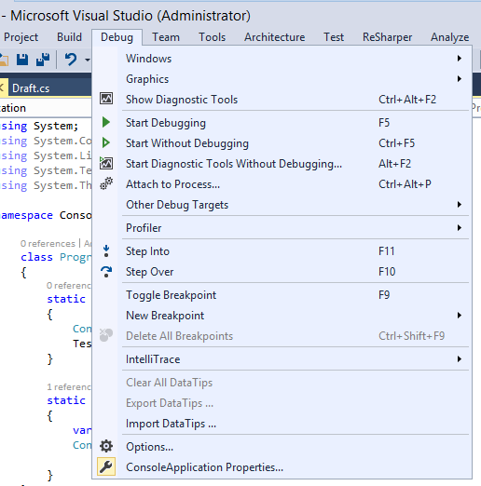
Debugging
Start Debugging

Slide 4
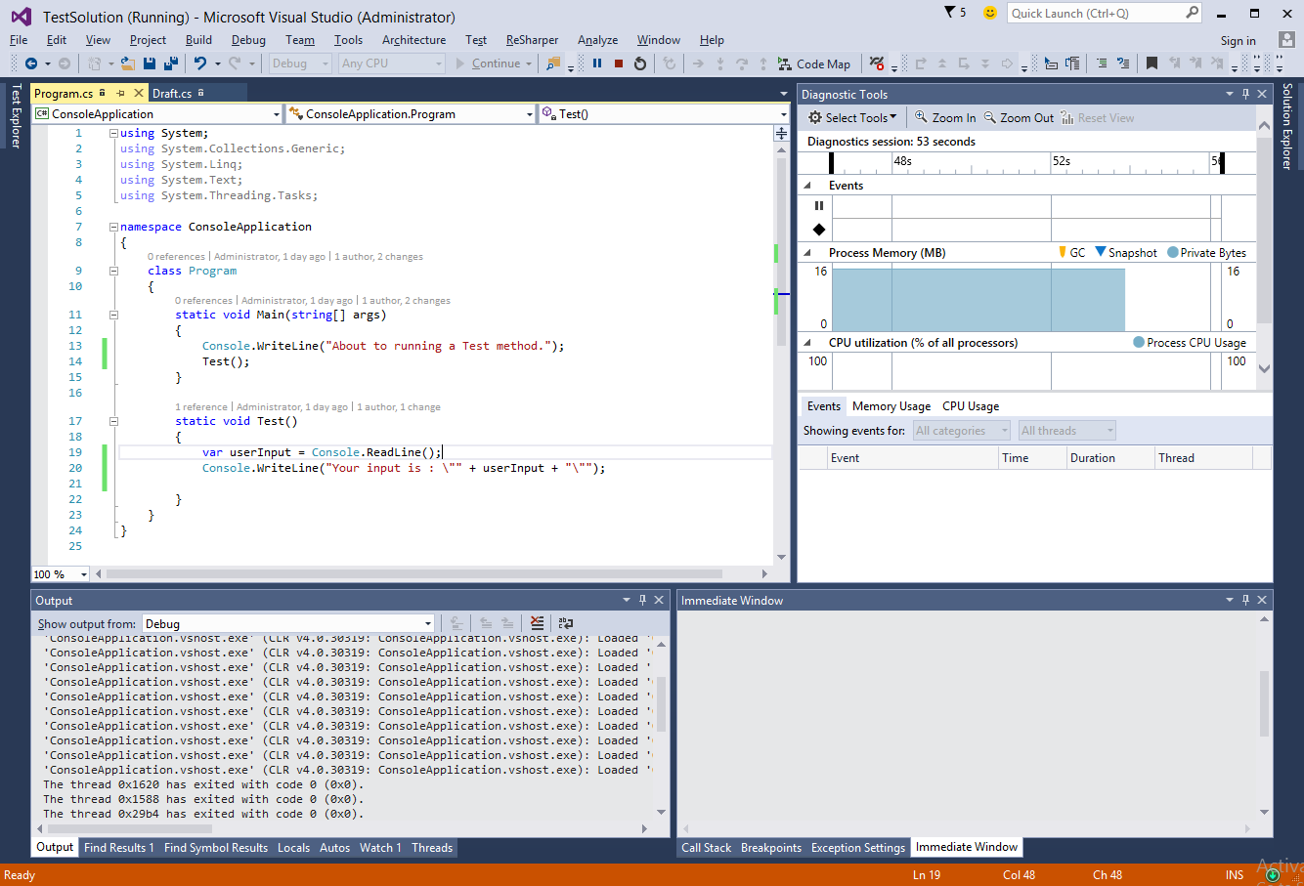
Debugging
Start Debugging

Slide 5
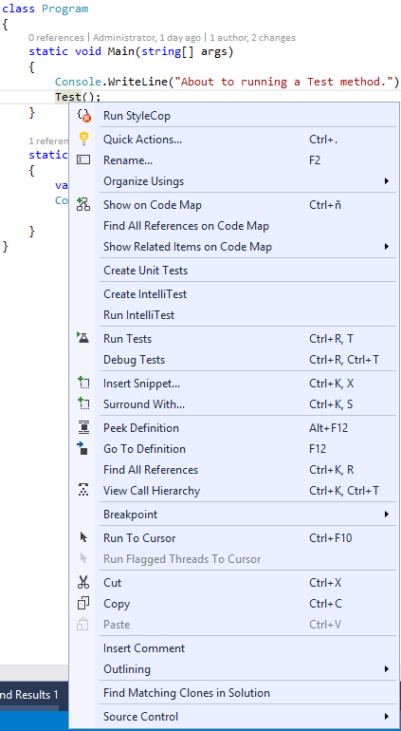
Debugging
Run to Cursor

Slide 6
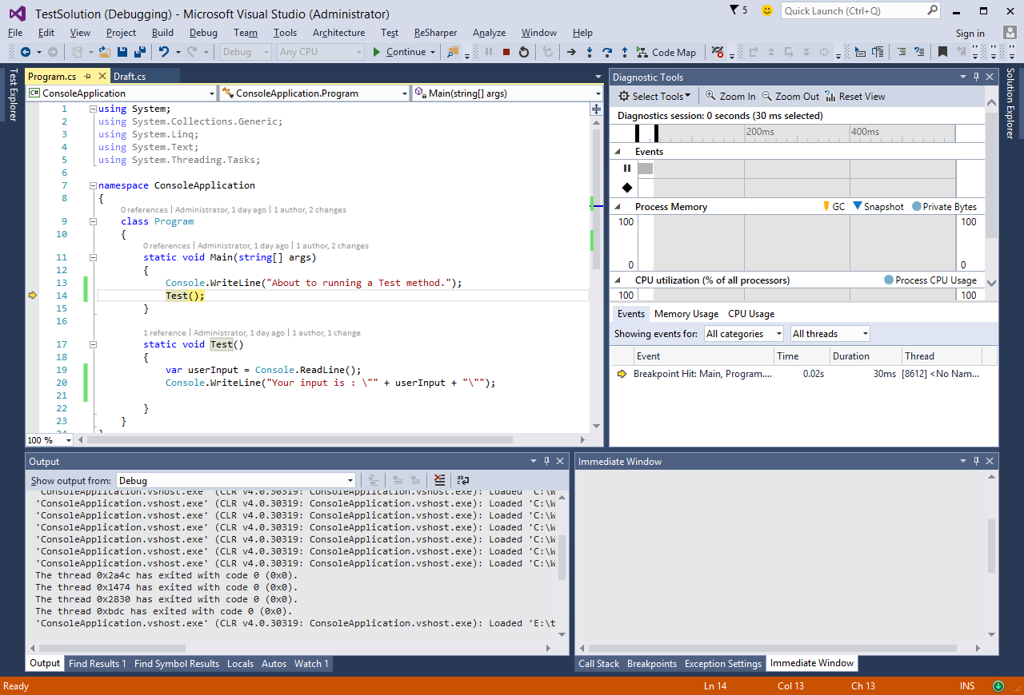
Debugging
Run to Cursor

Slide 7
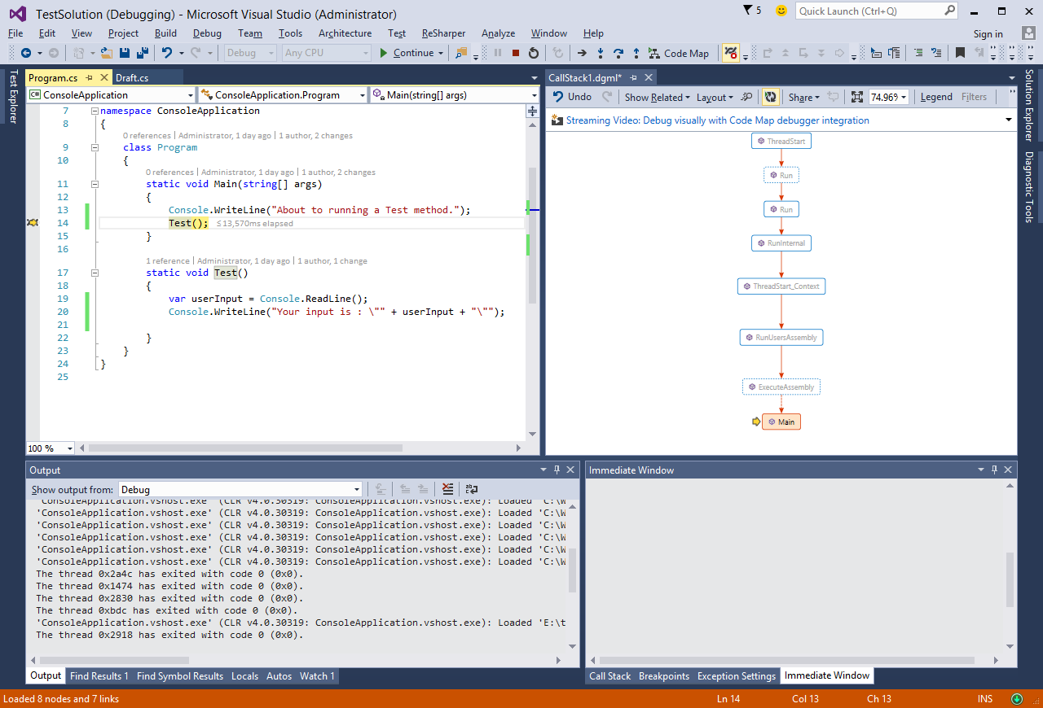
Debugging
Run to Cursor – Bar & Steps

Slide 8
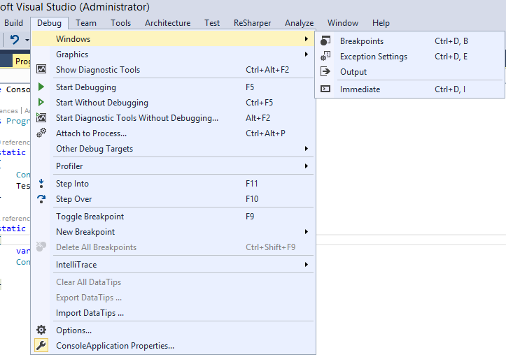
Debugging
Breakpoints

Slide 9
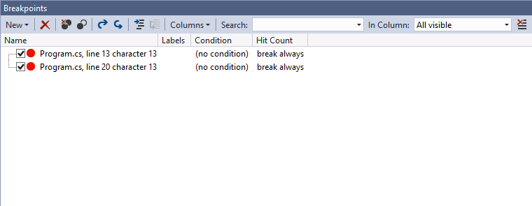
Debugging
Breakpoints - Window

Slide 10
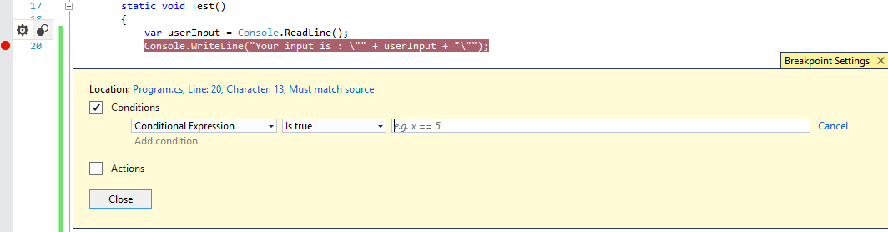
Debugging
Breakpoints - Conditions

Slide 11
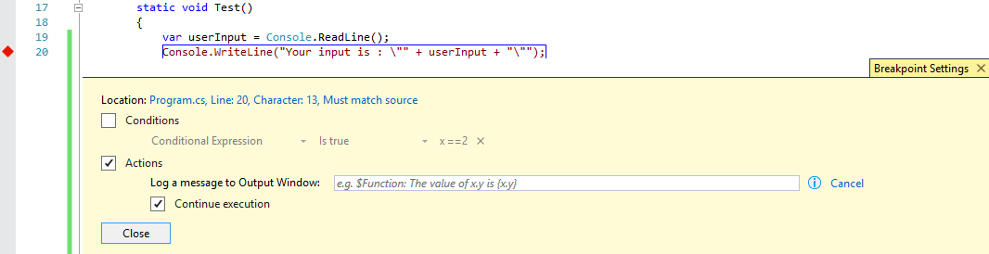
Debugging
Breakpoints - Actions

Slide 12
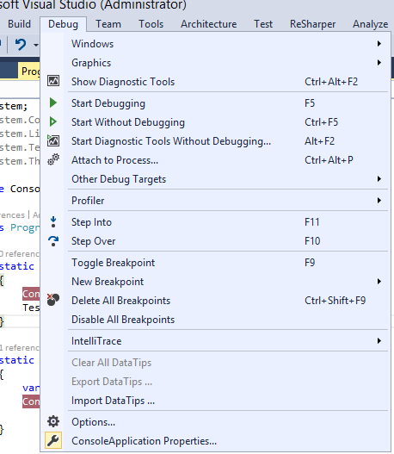
Debugging
Attach to Process

Slide 13
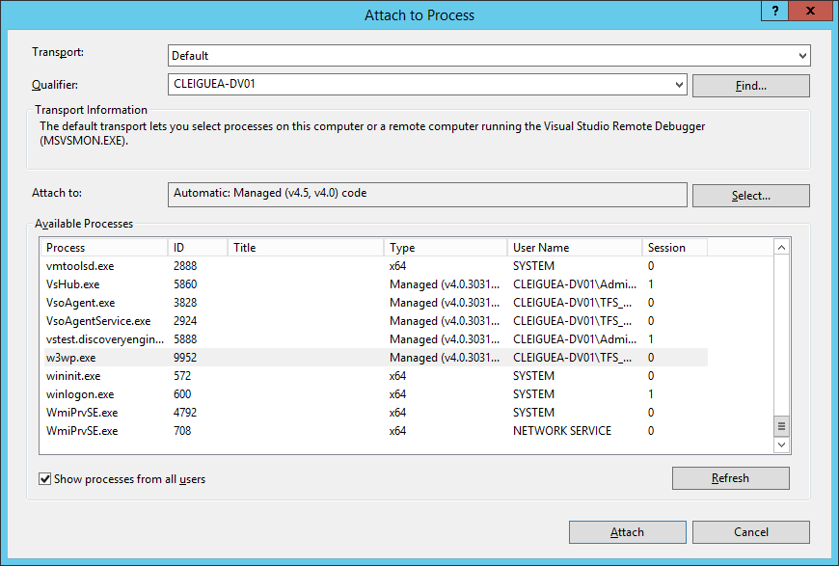
Debugging
Attach to Process

Slide 14
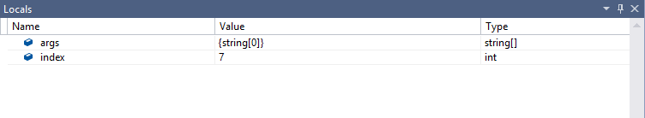
Debugging
Windows - Locals

Slide 15
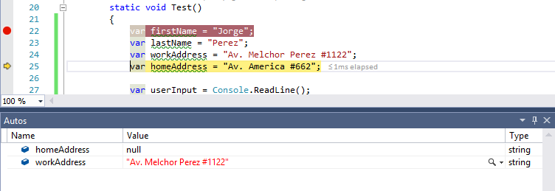
Debugging
Windows - Autos

Slide 16
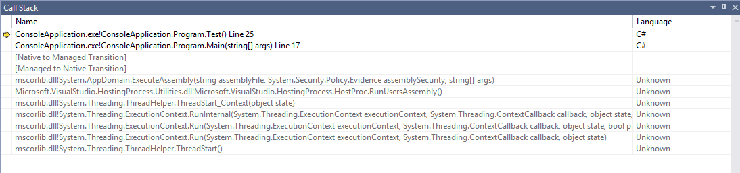
Debugging
Windows – Call Stack

Slide 17
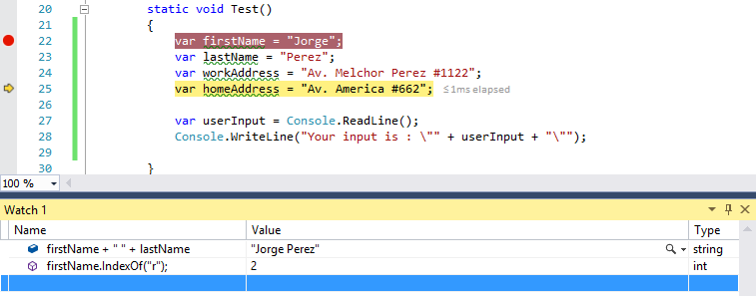
Debugging
Windows - Watch

Slide 18
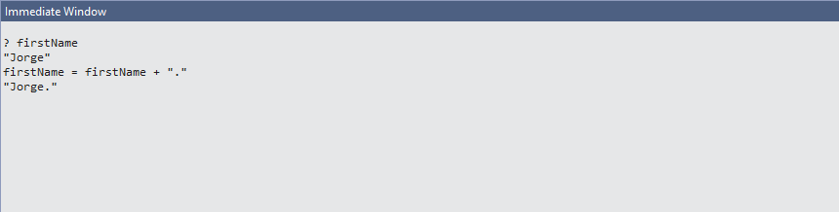
Debugging
Windows - Immediate

